Slide 1
AUTONOMOUS
CARS
Who should be held legally accountable in event of an accident?

Slide 2
01
BACKGROUND

Slide 3
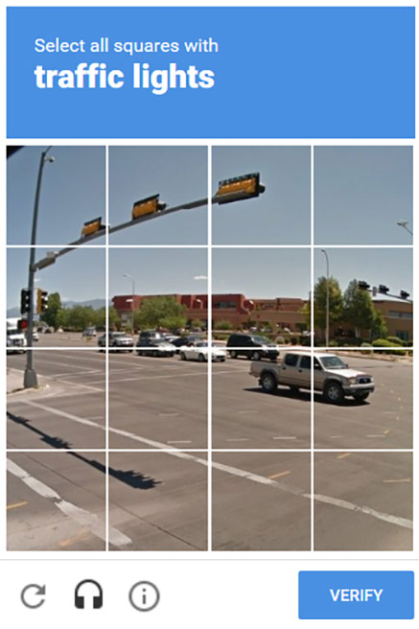
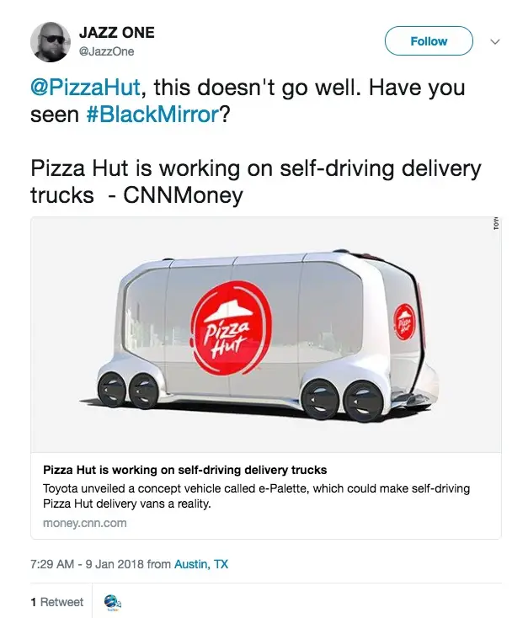

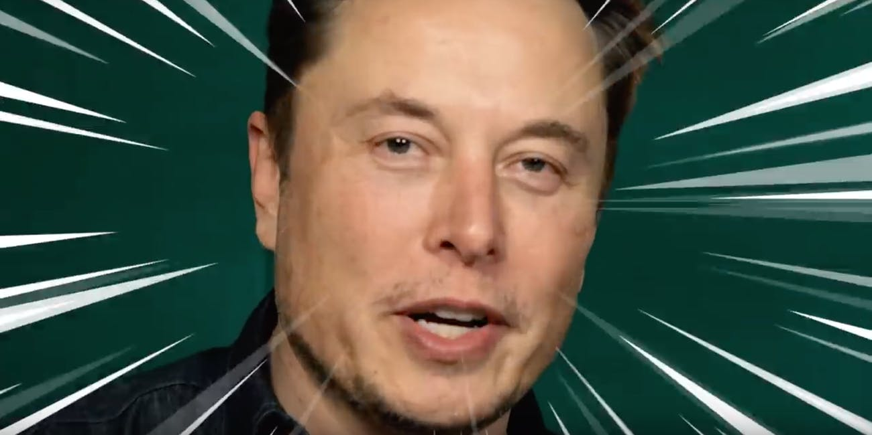

Day to day life
Celebrity
Pop Culture
Notes:
Autonomous cars are already somehting that is engrained in our lives and is not this idea of the future.
You’ll have seen Google’s captcha’s which are used in the training of AI driving, threse contain images of roads usually, pdestrian crossings we see these all the time
And even big nbames in the industry are becoming part of celebrity culture and even in pop culture autonomous cars are everywhrre, For example Pizza hut working on their AI pizza delivery truck was uncannily familiar to the black mirror episode where somoene was killed but an AI pizza truck

Slide 4
LEVELS OF AUTONOMY
1
Partial Automation
High Automation
Level 2
Level 4
Level 1
Level 3
Level 5
Driver Assistance
Conditional Automation
Full Automation
Notes:
Level 1 ("hands on"): The driver and the automated system share control of the vehicle.
Examples are Cruise Control, Adaptive Cruise Control, Parking Assistance, Lane Keeping Assistance, Automatic Emergency Braking
Level 2 ("hands off"): The automated system takes full control of the vehicle: accelerating, braking, and steering. The driver must monitor the driving and be prepared to intervene immediately at any time if the automated system fails to respond properly. Usually wheel contact at all times
Level 3 ("eyes off"): The driver can safely turn their attention away from the driving tasks
The vehicle will handle situations that call for an immediate response, like emergency braking.
The driver must still be prepared to intervene within some limited time, specified by the manufacturer, when called upon by the vehicle to do so.
Level 4 ("mind off"): As level 3, but no driver attention is ever required for safety, e.g. the driver may safely go to sleep or leave the driver's seat. Self-driving is supported only in limited spatial areas (geofenced) or under special circumstances. Outside of these areas or circumstances, the vehicle must be able to safely abort the trip, e.g. park the car, if the driver does not retake control. An example would be a robotic taxi or a robotic delivery service.
Level 5 ("steering wheel optional"): No human intervention is required at all. An example would be a robotic taxi that works an all roads all over the world, all year around, in all weather conditions.

Slide 5
02
ETHICAL HOT TOPICS
For Autonomous Cars

Slide 6
Human Safety
Cyber Security
Hacking
Data
Who owns it?
What will they do with it?
ETHICAL ISSUES
Liability
Who is to blame?
Notes:
There’s many ethical issues associated with Autonomous cars, from human safetly - are the people inside the are safe and re the people outside, other dirvers, pedestrians safe?

Slide 7
KEY POINTS
Scale
AI
Many companies are working on some level of autonomous car including Google, Tesla and Uber. But a decision about who should be held accountable needs to be made before fully autonomous cars start driving around.
An AI cannot really make an ethical split-second decisions to swerve to avoid a child running into a road, thereby hitting a pedestrian or not when either decision is a decision to cause harm.
Notes:
Globablly autonomous cars are being developed by many companies and most car manufacterers are working on them so rules definitely need to be set about accountablility
The AI itself cannot really be to blame
WHen it comes to AI there is a huge difference between a humans automatic reaction and an AI’s calculate decision to choose one life over another

Slide 8
03
LIABILITY
Who could realistically be to blame?

Slide 9
IN THE EVENT OF AN ACCIDENT
When it is human lives that have been harmed, who can reasonably be held accountable?

Slide 10
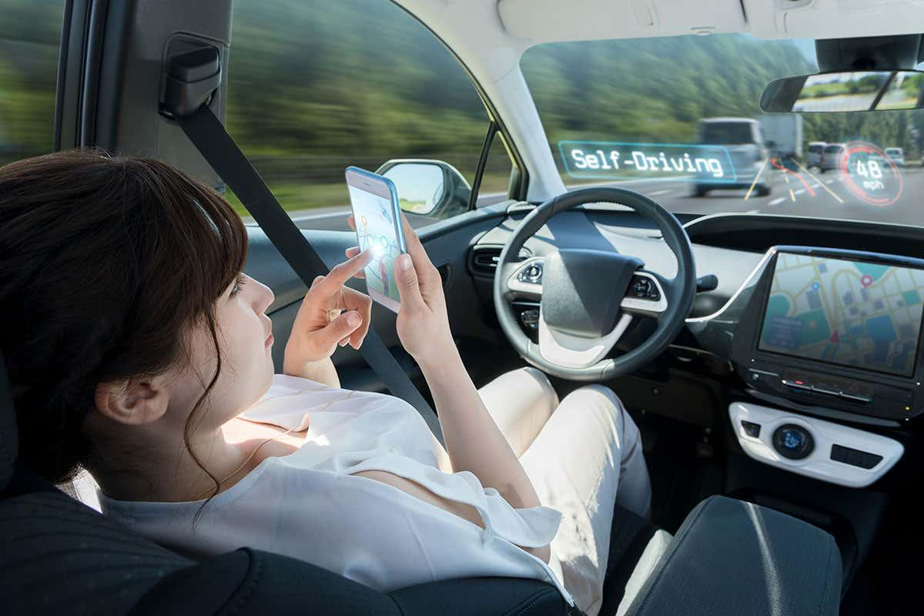
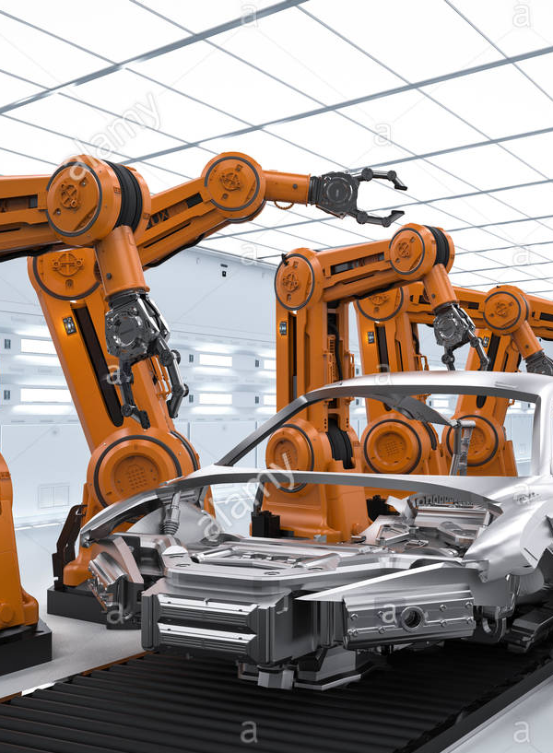


LIABLE PARTIES
VEHICLE OPERATOR
CAR MANUFACTURER
INSURANCE COMPANIES
TECH
DEVELOPERS
The person who is seated in the driver’s seat or the operator of the car
The manufacturer responsible for installing autonomous technology into the vehicle.
The companies that permit and insure users of autonomous cars
The developers of the autonomous car technology and sensor systems that allow a vehicle to detect its surrounding.

Slide 11
PASSENGER IN THE DRIVER’S SEAT
THE OPERATOR
The passengers for getting into the car
If they can take over the control of the car
It was their choice to use the car - assuming they are aware that it is not 100% safe
Whoever engages the car
If control cannot be handed to a human driver
If a passenger never had a real chance to intervene, can they legitimately be held responsible?
103 people are killed in the US in motor-vehicle accidents every day, and more than 94% of crashes are due to driver error 2

Slide 12
MANUFACTURERS
Make and sell the products so are responsible for putting them into the public.
Volvo are an example of an organisation taking responsibility here.
Will people be more willing to accept the risk if they know they cannot take the blame?

Slide 13
INSURANCE COMPANIES
The insurers are able to build policies and make judgements as to who and how autonomous care are used.
They may be driven by opportunities to make a profit in and this needs to be second to deciding autonomous car use suitability

Slide 14
TECH DEVELOPERS
In creating this technology, the developers should be asking questions about how it will be used, misused or malfunction.
If it is misused or malfunctions, are the designers accountable for creating it in the first place?

Slide 15


Current Stances
Tesla CEO Elon Musk has blamed crashes involving Autopilot on driver overconfidence.
“When there is a serious accident it is almost always, in fact maybe always, the case that it is an experienced user, and the issue is more one of complacency,” - Musk, 2018
Prosecutors have ruled that the company is not criminally liable for the death of Elaine Herzberg, 49, who was struck as she crossed a road in Tempe, Arizona.
The car's back-up driver could still face criminal charges.
A police report has previously called the incident "entirely avoidable".
Taking full responsibility
“if we made a mistake in designing the brakes or writing the software, it is not reasonable to put the liability on the customer...we say to the customer, you can spend time on something else, we take responsibility.”

Slide 16
04
RECOMMENDATIONS
What are my personal opinions and recommendations?

Slide 17
RECOMMENDATION?
No cars, no problem!
Obviously that is not realistic
Autonomous cars could be a great benefit to society
Freeing up time for non-driving activities
Potential car-sharing, no one needing their own car
Reduction of human error accidents
It is clear than rules need to be set out so that autonomous car users know their liabilities and responsibilities before buying autonomous cars/using services that use them
Examples like Volvo are good but we have seen what happens when we remove the blame from the individual...

Slide 18
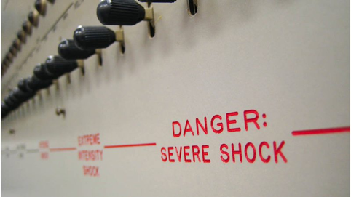
...MILGRAM (1963)
Notes:
Thus was an experiment in the 60s which had people ad inister increasingly severe shocks, uo to a stenght that had clear warnings about how dangerous it was to a person (they were an actor but the participants didn’t know that) on the other side of a wall just because they were following orders from an authority figure and therfore did not feel they held the blame for any injury caused to the other party

Slide 19
Personal Opinion
Ultimately I believe that people using the cars should be held criminally accountable for choosing to do so and accepting the risks involved.
But in cases where the car malfunctions, the manufacturers should be financially responsible

Slide 20
TO PROGRESS!
Ultimately, experts tell us, autonomous vehicles will be safer, cheaper, and more convenient.
To make autonomous cars more efficient and cause fewer casualties, they need to be tested in real situations to ultimately reduce the number of casualties overall.

Slide 21

Thanks for Listening
Any questions?

Slide 22
Thanks!
Any Questions?

